Slide 1
Phishing Awareness Training
Understanding, Identifying & Preventing Phishing Attacks
Cyber Security
Prepared by: Ledet Tamiru

Slide 2

HELLO!
I am Ledet Tamiru
I am Cyber Security Student I need to give awareness training about Phishing
You can find me at ledet1026@gmail.com

Slide 3

Phishing Awareness
Internship: CodeAlpha cybersecurity Internship
Date:July 23, 2025

Slide 4
01
Definition & Types of Phishing
Contents
02
How To Recognize Phishing Attacks
03
Social Engineering Tactics Used In Phishing
04
Real World Examples Of Phishing

Slide 5

What comes to your mind when you hear the word phishing?

Slide 6
Introduction
Phishing is one of the most prevalent and potentially dangerous types of cyberattacks that are increasing exponentially in this new age of the digital world. Phishing is a skill by which cybercriminals gain unauthorized access to computers or pilfer sensitive information. All these harmful attacks, all for deceiving people into sharing personal information, can be sent via phone, SMS, email, or even imitated websites. The aim of this presentation is to heighten your awareness of phishing, find the different types of phishing attacks, and provide useful tips on how to protect your company and yourself.

Slide 7
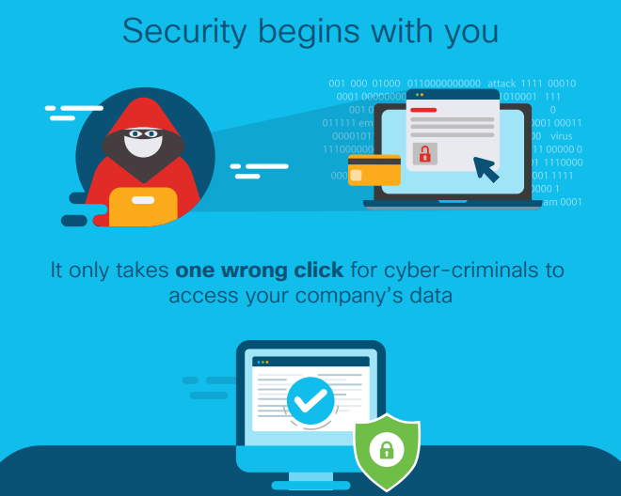

Slide 8
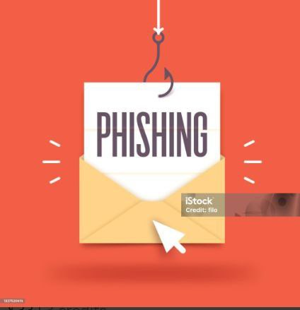
What Is Phishing
Phishing is a type of cybercrime where attackers trick individuals into revealing sensitive information, such as usernames, passwords, credit card details, or other personal data, by impersonating a trustworthy entity.
This is typically done through deceptive emails, text messages, or websites designed to look legitimate.
Phishing attacks often involve sending out mass emails or text messages that appear to be from banks, social media platforms, or other trusted organizations.
The ultimate goal of a phishing attack is to steal money, gain access to sensitive accounts (like email or social media), or install malware on the victim's device.
MEMBER NAME
DIRECTOR
Easy to change colors, photos and Text.

Slide 9
Types of Phishing Attacks
where an attacker uses phone calls or voice communication to deceive individuals into revealing sensitive information such as, Personal details, password, credit card Numbers.
.
Exploits SMS, or text, messages. Text messages can contain links to such things as webpages, email addresses or phone numbers that when clicked may automatically open a browser window or email message or dial a number.
Vishing Attacks
Smishing Attacks
Spear Phishing
targeted attack appearing to come from a trusted source, often within the victim's own company, from someone in a position of authority.
.
Whaling:
specific attack targeting high profile business executive, upper management, CEO, etc.

Slide 10
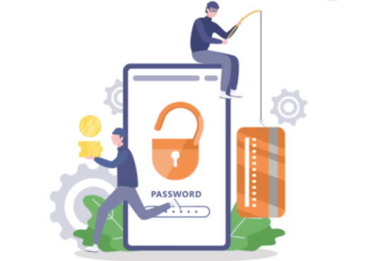

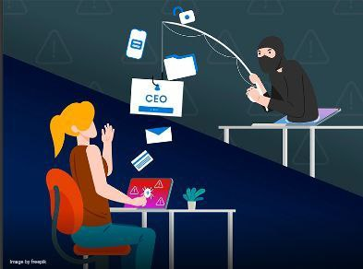
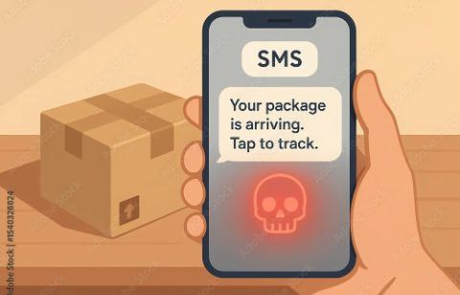
CON’T
Vishing Attack
Spear phishing
Whaling
Smishing Attack

Slide 11

Have you ever received a suspicious email or message? What made you question it?

Slide 12
How To Recognize Phishing Email & Websites

Slide 13
Identifying Phishing Email
Sense of Urgency:
Suspicious Sender:
Phishing emails frequently create a false sense of urgency or fear, pressuring you to act quickly
Check the sender's email address for misspellings, unusual domains, or if it doesn't match the supposed sender's organization.
.
Generic Greetings:
Grammar and Spelling Errors:
Phishing emails often use generic greetings like "Dear Customer" instead of your name.
Poor grammar, spelling mistakes, and awkward phrasing are common red flags.

Slide 14
CON’T
Unexpected or Unusual Content:
Requests for Personal Information:
Be cautious of emails that contain unexpected content or requests, especially if they seem out of character for the sender.
Be highly suspicious of any email asking for sensitive information like passwords, credit card details, or social security numbers.
.
d
Unusual Attachments:
d
Suspicious Links:
Avoid opening attachments from unknown or suspicious senders.
.
Hover over links to see the actual URL before clicking. Phishing sites often disguise malicious links

Slide 15
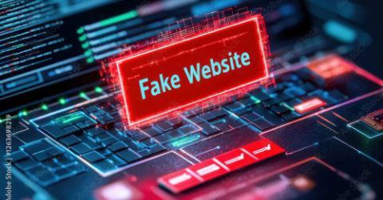
Identifying Fake Websites
Suspicious URLs:
Missing Contact Information:
Carefully examine the website's URL for misspellings, unusual characters, or a domain name.
I hope and I believe that this Template will your Time, Money and Reputation
D
A
Unrealistic Offers:
Lack of HTTPS:
Be skeptical of websites that offer unrealistic deals or ask for sensitive information without proper security measures.
Legitimate websites use HTTPS to encrypt data.
E
B
Poor Design and Content:
Fake websites may have low-quality images, broken links, spelling errors, or a generally unprofessional appearance.
Payment Methods:
Reputable websites typically accept credit cards, but phishing sites may ask for bank transfers or other unusual payment methods.
F
C

Slide 16

What would you do?
If you received a message asking for personal information, what steps would you take to verify it?

Slide 17
Social Engineering Tactics Used in Phishing
Phishing attacks leverage various social engineering tactics to trick users into revealing sensitive information or taking actions that compromise their security.
These tactics often exploit human psychology to create a sense of urgency, trust, or fear, making victims more susceptible to manipulation.
Here's a breakdown of common social engineering tactics used in phishing attacks:

Slide 18
Con’t
Impersonation
You can simply impress your audience and add a unique zing and appeal to your Presentations. Easy to change colors, photos and Text.
Offering Enticing Rewards:
Attackers may promise free prizes, discounts, or other rewards to lure victims into clicking malicious links or providing information.
Creating Urgency and Fear:
This tactic aims to bypass critical thinking and prompt hasty responses.
Threats of account suspension or legal action are also used to create fear and pressure.
Exploiting Authority:
Attackers might impersonate high-ranking individuals like CEOs or IT managers to create an aura of authority.

Slide 19
Con’t
Tailgating and Piggybacking:
In physical social engineering, attackers might follow an employee through a secure door, claiming to have forgotten their badge.
Smishing and Vishing:
These attacks often mimic legitimate organizations or services to gain trust.
Pretexting:
Attackers create a fabricated scenario to deceive victims into divulging information.
Quid Pro Quo:
Attackers offer a service or benefit in exchange for sensitive information or access.
.

Slide 20

Can you stop them?
Which of the social engineering tactics mentioned do you think is the most effective — and why?

Slide 21
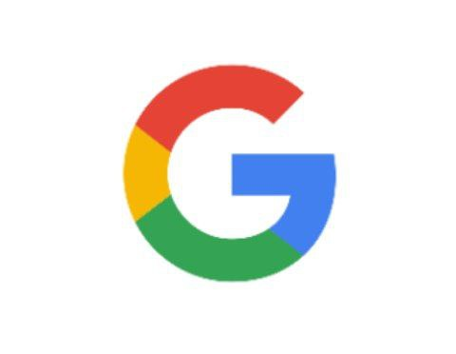
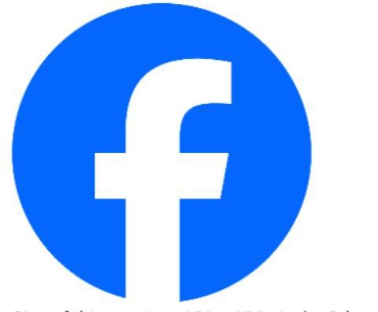
Phishing Attacks: Real-Life Examples
Google and Facebook Phishing Attack
The attackers took advantage of the fact that both companies had a Taiwanese supplier called Quanta.
Between 2013 and 2015, a phishing campaign caused Facebook and Google losses of $100 million.
The attackers sent a series of fake invoices, pretending to be from Quanta, and the invoices were paid by Facebook and Google.

Slide 22
Con’t
Colonial Pipeline
Major fuel supplier hit by ransomware. Operation halted after phishing compromised billing system $4.4 million ransom paid
Levitas Capital (2020 - Australia) Whaling attacks via fake Zoom link. Malware generated fake invoices. $800,000 loss + major reputational damage.
Elara Caring (2020 - USA)
Healthcare provider targeted via phishing emails. Only 2 employee account breached. Exposed data of 100,000+ elderly patients

Slide 23
CON’T
USPS Smishing Attack (2020 - USA)
MS scam pretending to be USPS delivery. link led to fake Google login pages. Stole user credentials through mobile phishing
PHISHING Examples
Spectrum Health (2020 - USA)
Attackers posed as employees calling patients. Used social engineering to steal health data and member IDs. Techniques included flattery and intimidation.
U.S. Interior Department (2020 - USA)
Attack used "evil twin" Wi-Fi phishing. Fake access point stole credentials. Revealed weak wireless security and lack of monitoring.
.
Crelan Bank (Belgium)
Business Email Compromise(BEC) scam. Executives’ account were used to transfer funds. Loss of over $75 million, discovered in internal audit.

Slide 24
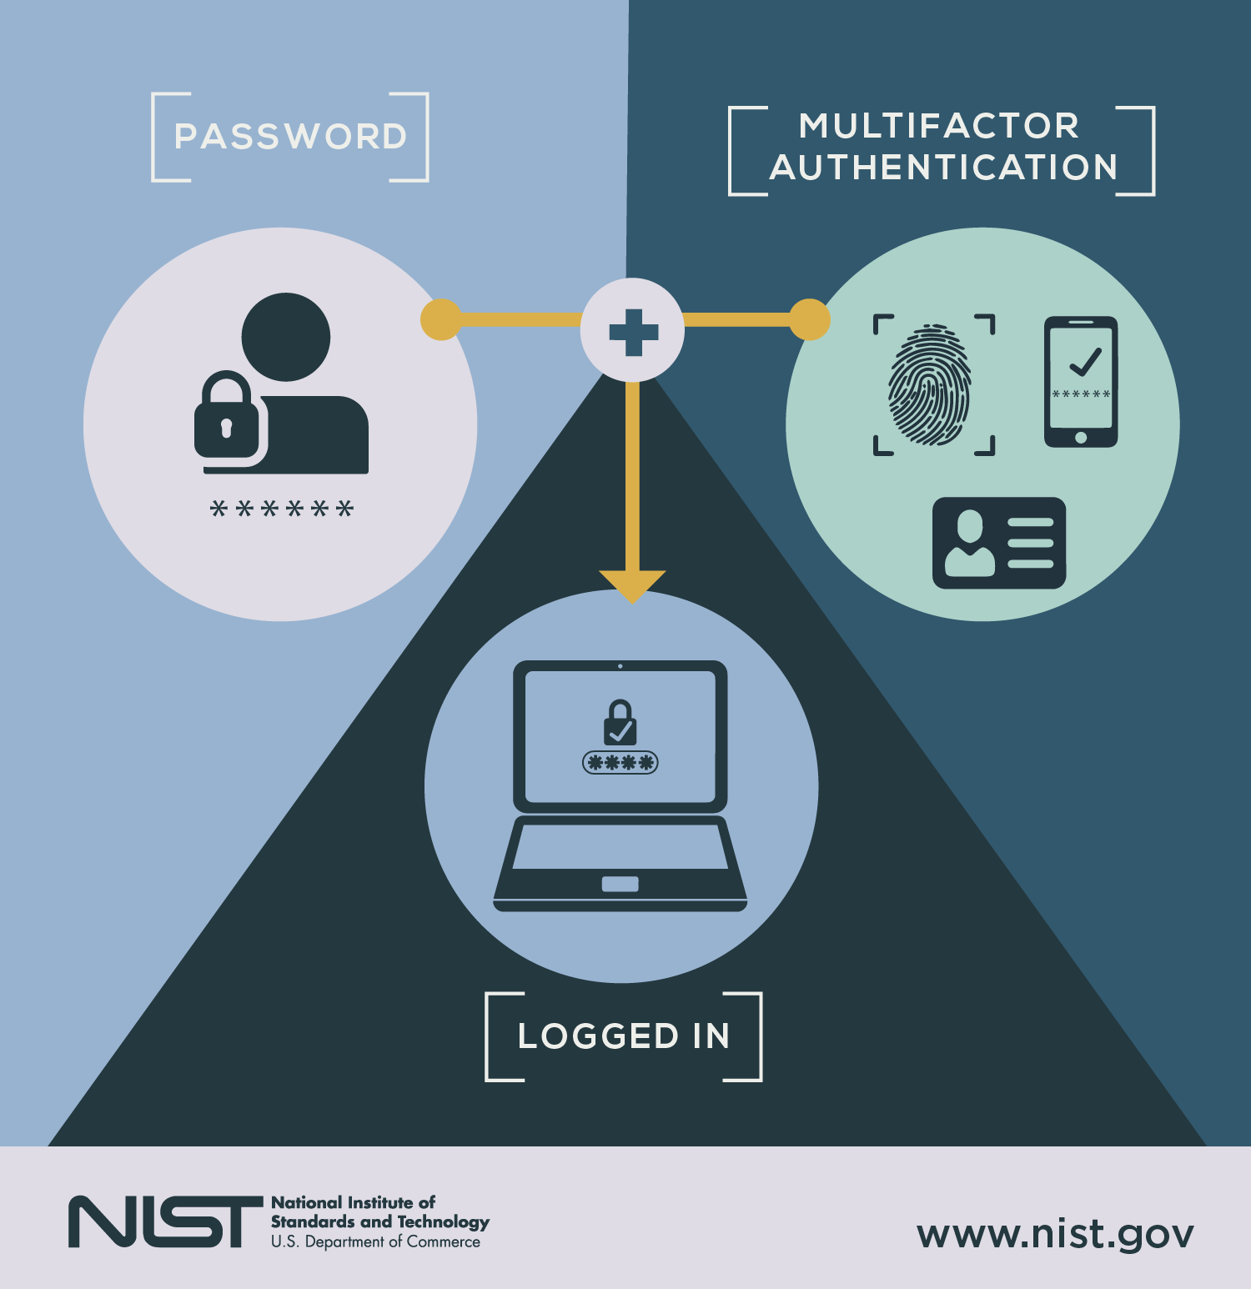
Best Practices And Prevention Tips

Slide 25
For Individuals
Enable multi-factor authentication (MFA):
Verify requests:
If an email asks for personal information or money, contact the organization directly through their official website or phone number to verify the request.
MFA adds an extra layer of security by requiring a code from your phone or another device in addition to your password.
.
Keep software updated:
Regularly update your operating system, web browser, and other software to patch security vulnerabilities.
Check for red flags:
Be cautious of unexpected emails:
Look for misspellings, grammatical errors, urgent language, and generic greetings in suspicious emails.
Don't click on links or open attachments from senders you don't know or if the email seems suspicious.
Be careful on public Wi-Fi:
Use strong passwords:
Avoid accessing sensitive information or making financial transactions on public Wi-Fi networks.
.
Create strong, unique passwords for all your accounts and avoid using the same password for multiple accounts.

Slide 26
For Organization
Provide security awareness training:
Conduct regular phishing simulations:
Educate employees on how to identify and report phishing attempts.
.
Test employees' ability to recognize and respond to phishing attempts.
Enforce strong password policies and MFA:
Implement email authentication protocols:
Use protocols like SPF, DKIM, and DMARC to verify the authenticity of emails.
.
Ensure employees are using strong passwords and have MFA enabled for their accounts.
Use email filtering and anti-phishing tools:
Establish a reporting process:
Encourage employees to report suspicious emails and other phishing attempts to the IT security team.
.
These tools can detect and block phishing emails.
.

Slide 27
Con’t
Use secure web gateways and DNS filtering:
Regularly update and patch systems:
Keep software and systems up-to-date to address security vulnerabilities.
These tools can help block access to malicious websites and protect users from phishing attacks.

Slide 28

What are the 2 most important things you learned today that will help protect you from phishing?

Slide 29
CONCLUSION
However, with increased awareness, careful attention, and strong security practices—like verifying suspicious messages, enabling multi-factor authentication, and keeping software up to date—we can greatly reduce the risk of falling victim to phishing. Phishing remains a persistent and dangerous cybersecurity threat that affects people and organizations across all industries. Attackers are constantly coming up with new ways to attack, from simple scam emails to complex social engineering tactics.

Slide 30
References
CISA. (2023). Phishing Guidance. https://www.cisa.gov/sites/default/files/publications/CISA_Phishing_Guidance_508C.pdf
Cloudflare. (n.d.). Types of phishing attacks. https://www.cloudflare.com/learning/security/threats/phishing/
Phishing.org. (n.d.). What is Phishing?
https://www.phishing.org/what-is-phishing
OpenLearn. (n.d.). Introduction to Cyber Security.
https://www.open.edu/openlearn/science-maths-technology/introduction-cyber-security/content-section-overview

Slide 31
THANK YOU
Understanding, Identifying And Preventing Phishing Attack

